Slide 1

DATS 6103 Team 7
Navigating Mental Health Landscapes and Mortality Trends Globally
Presented by :
Siyu Du
Sailesh Baabu Suresh Babu
Yasaswitha Gaddam

Slide 2
Introduction
Our project seeks to analyze global mental health data, focusing on its intricate relationship with physical health indicators. By exploring comorbidity patterns, mortality trends, gender-based differences, and the connection between mental disorders and suicide rates, we aim to uncover comprehensive insights. This endeavor is driven by the recognition of the dynamic interplay between mental and physical well-being, aiming to contribute valuable knowledge that informs policies and interventions on a global scale. Our commitment is to foster a more informed and compassionate approach to mental health, transcending traditional boundaries for a holistic understanding.

Slide 3
Objective
To analyse global mental health data and its relationship with physical health indicators, with specific focus on
understanding comorbidity patterns, mortality trends, gender-based differences in mental health, and the
association between mental disorders and suicide rates.

Slide 4
About the Dataset
Our dataset contains data on suicide rates, mortality probability, and the prevalence of mental health disorders arranged by year and entity (such as nations or regions). Important factors should include rates of suicide, various mental health illnesses, and the likelihood of dying from particular diseases.
The dataset has 2898 rows and 11 columns.
Our Target Variable is Suicide

Slide 5
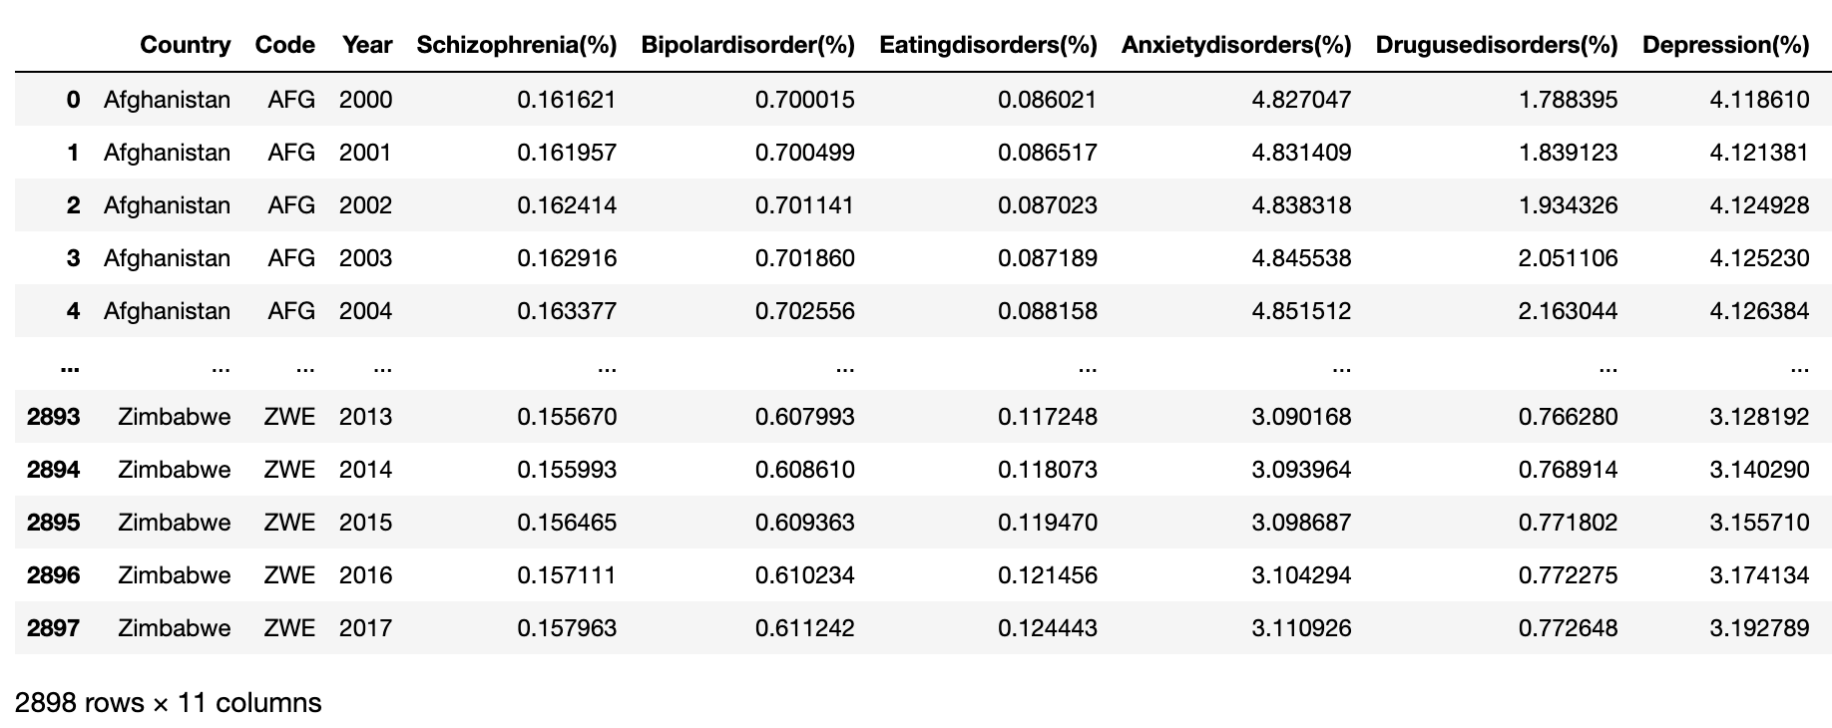
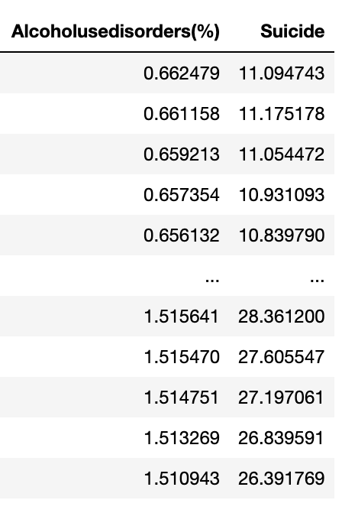
Dataset

Slide 6
Exploratory Data Analysis

Slide 7
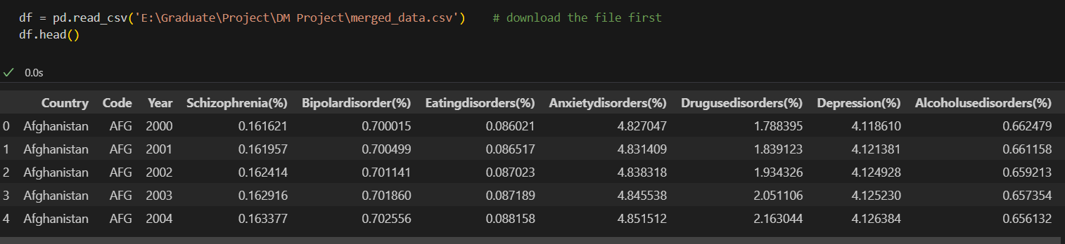
Understanding the Data

Slide 8
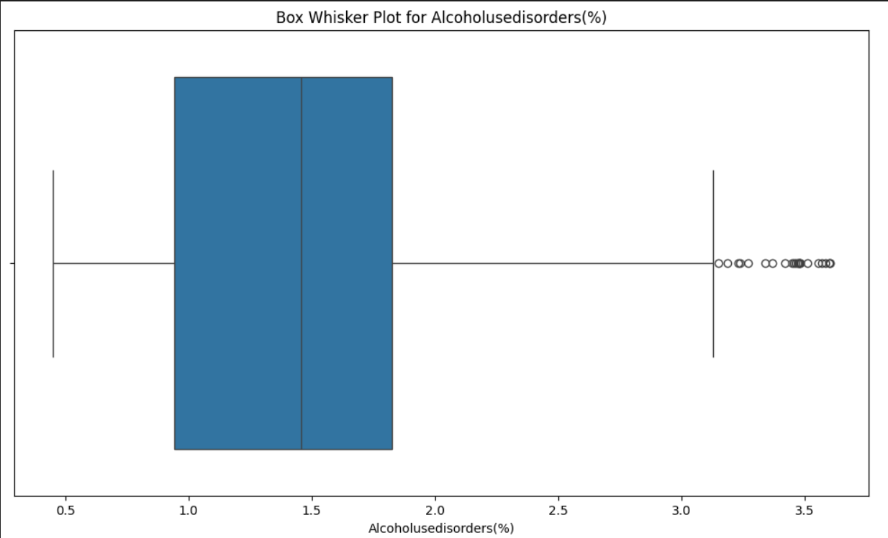
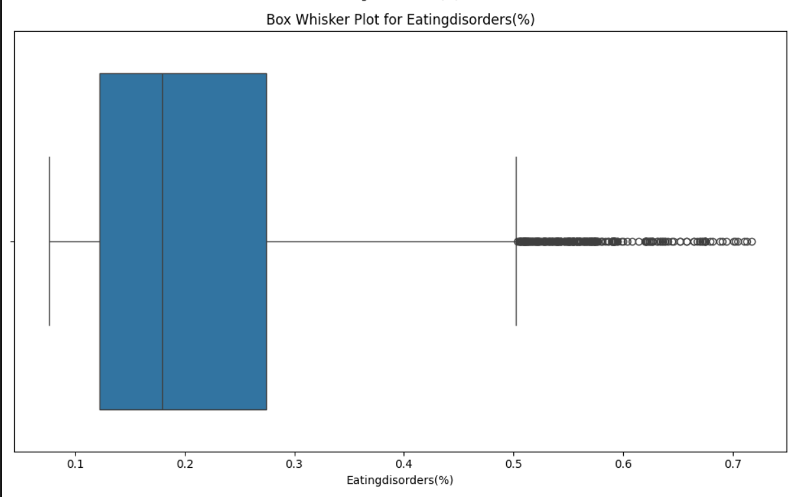
Box - Whisker Plot to detect the Outliers

Slide 9
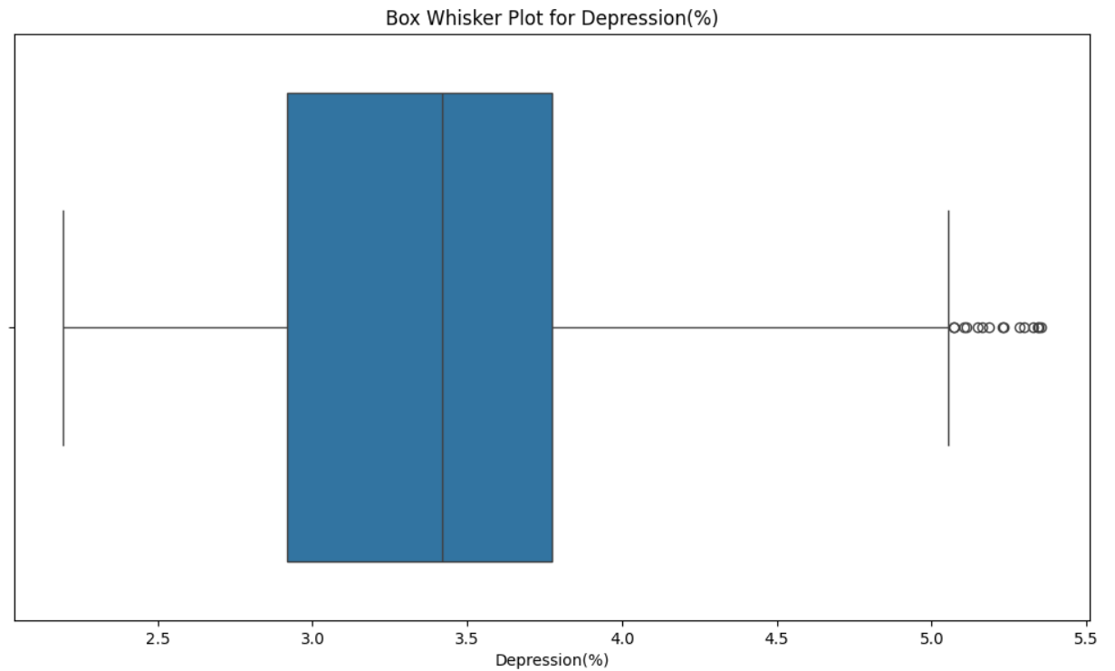
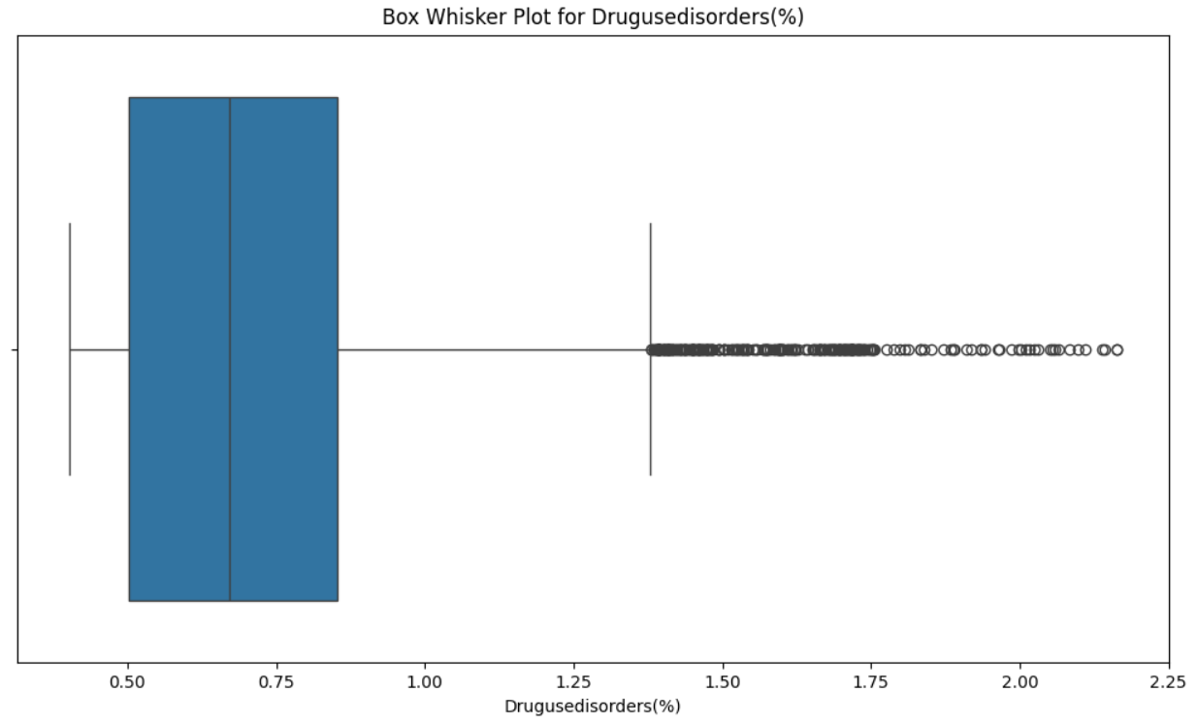
Box - Whisker Plot to detect the Outliers

Slide 10
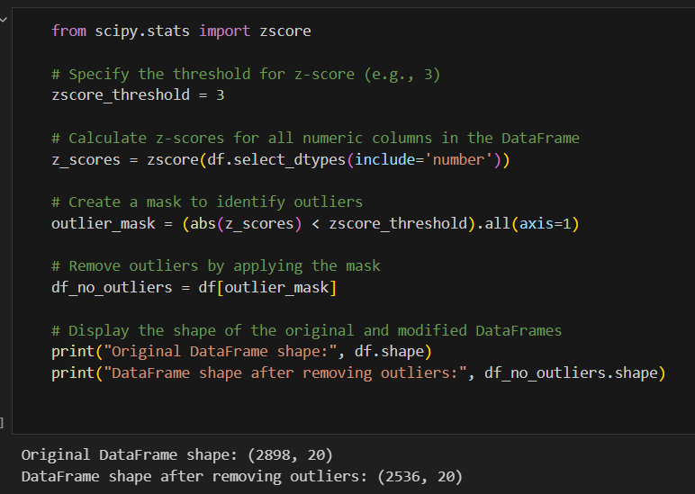
Outlier Removal using Z-Scores
The goal of removing outliers is to improve the reliability of our analysis.
The benefit of removing outliers is to enhance the accuracy and stability of statistical models and ML algorithms by reducing their impact on results.
Removing outliers using Z-scores helps improve the accuracy and reliability of statistical analyses and model results by reducing the influence of extreme values, leading to more robust and meaningful insights.

Slide 11
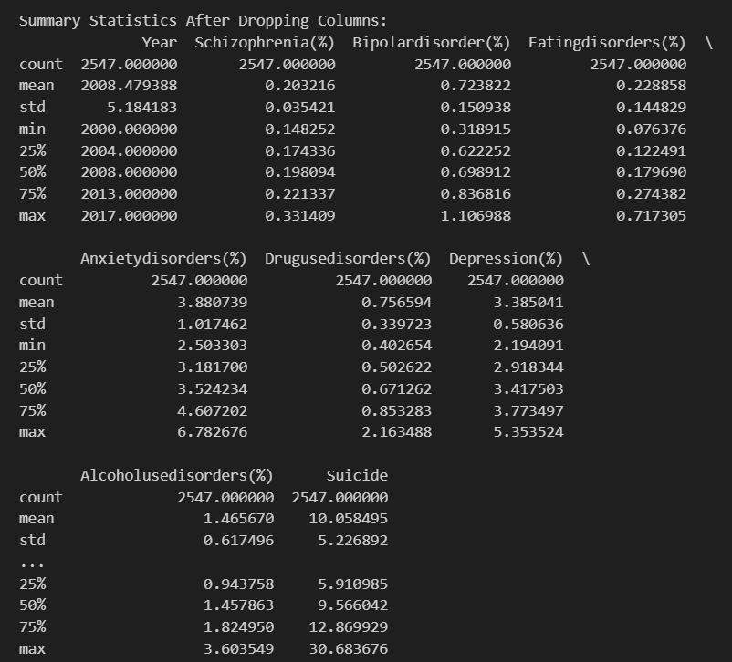
Summary Statics
This summary provides a concise overview of the prevalence and variability of different mental health conditions over the specified years. It can guide further analysis and interpretation of trends or patterns in mental health data.
In summary, summary statistics serve as a powerful tool in quantitative analysis, offering a condensed view of essential characteristics that facilitate a deeper understanding of the underlying data.

Slide 12
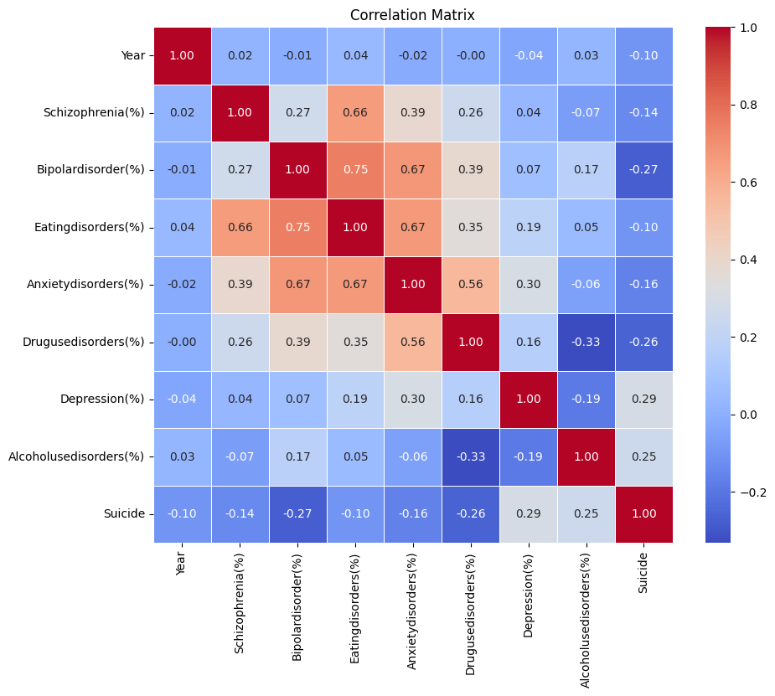
Correlation Matrix
Positive Correlation:
- Positive correlation values (closer to 1) indicate that as one variable increases, the other tends to increase. This implies a coordinated and positive relationship between the paired variables.
Negative Correlation:
- Negative correlation values (closer to -1) suggest an inverse relationship where as one variable increases, the other tends to decrease. This indicates a coordinated and negative association between the paired variables.
Zero Correlation:
- A correlation coefficient close to 0 signifies little to no linear relationship between the variables. In a scatter plot, points are scattered randomly, showing no clear trend or pattern as one variable changes.

Slide 13
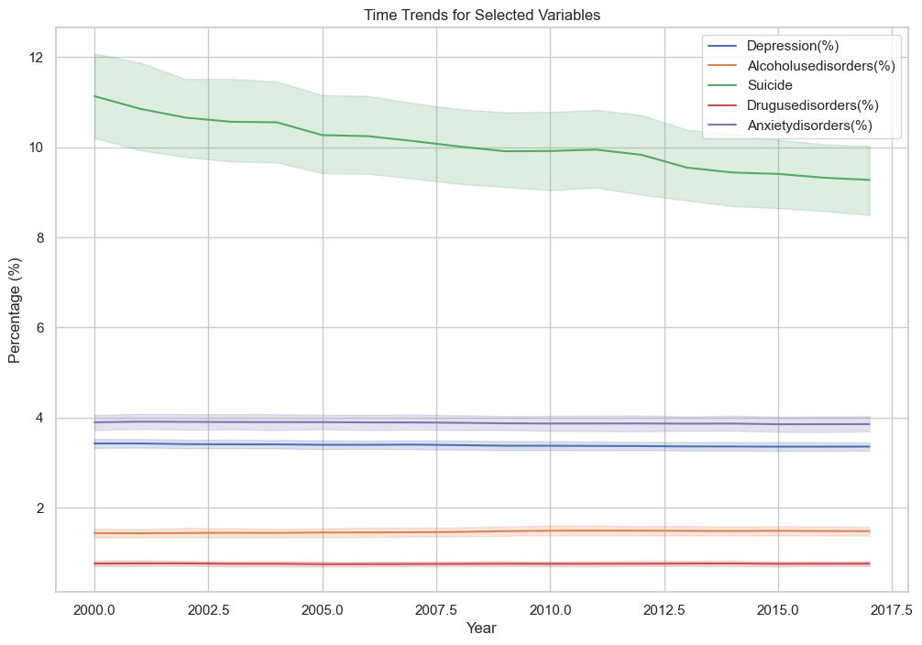
Time Trends
A time trend graph serves as a visual narrative, allowing for the quick and intuitive understanding of how a variable changes over time, making it a powerful tool for data communication and decision-making.
From this Time Trend graph we can infer that Suicide is getting decreased and other parameters are constant.

Slide 14
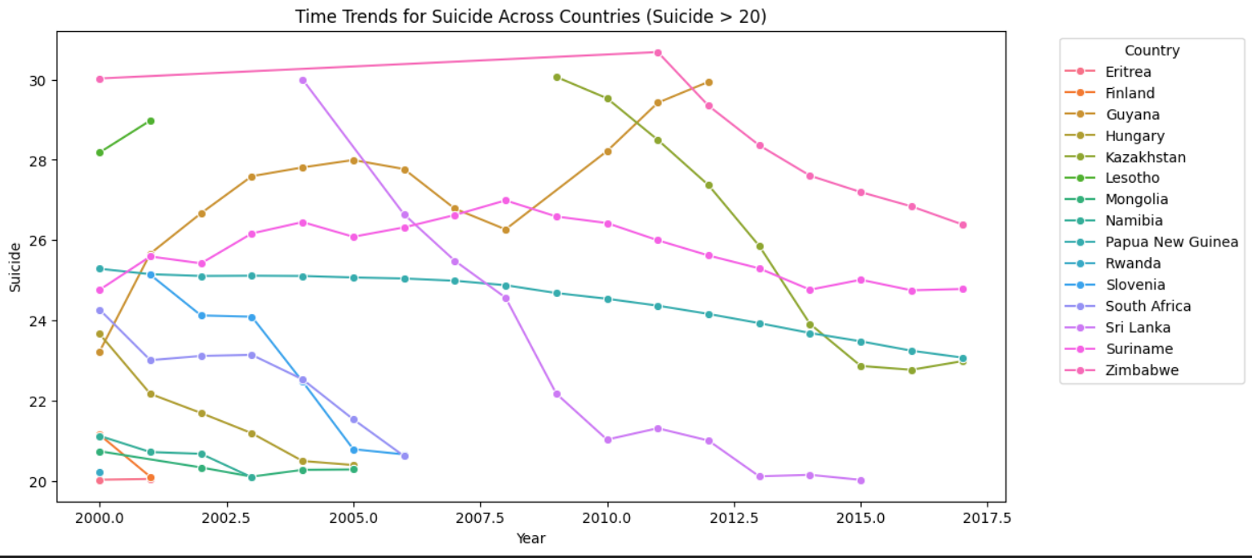
Time Trends for Suicide Across Countries
The graph shows the time trends for suicide rates across countries with suicide rates greater than 20 per 100,000 people.
It is also important to note that the suicide rates in these countries are still much higher than the global average. The global suicide rate in 2016 was 10.5 per 100,000 people. This suggests that there is still a lot of work to be done to prevent suicide in these countries.

Slide 15
Visualization

Slide 16
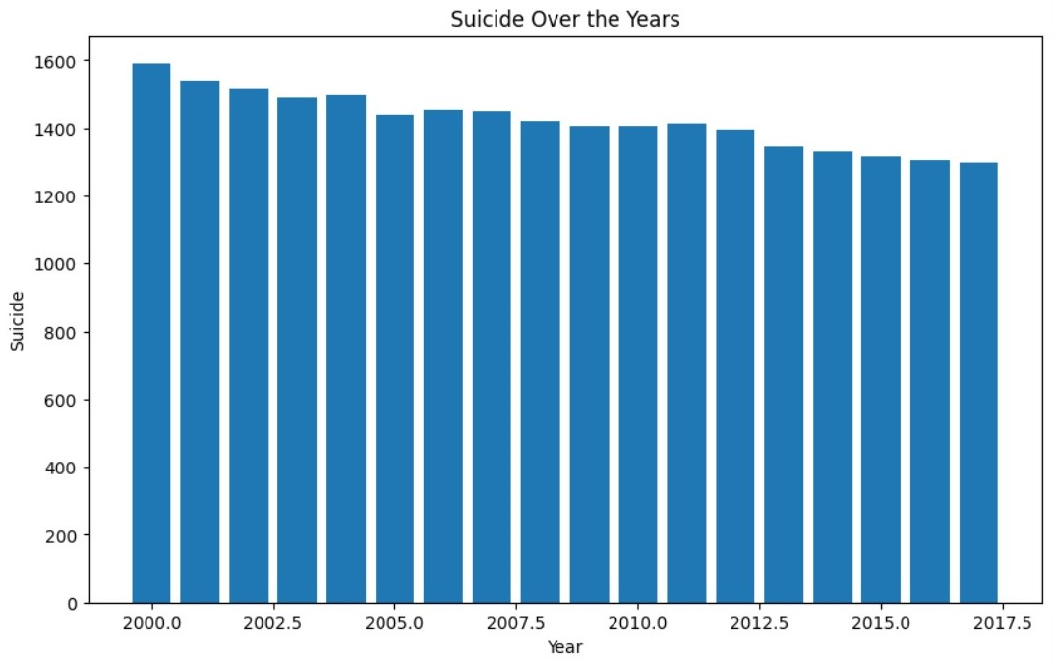
Suicide Rates Over Time

Slide 17
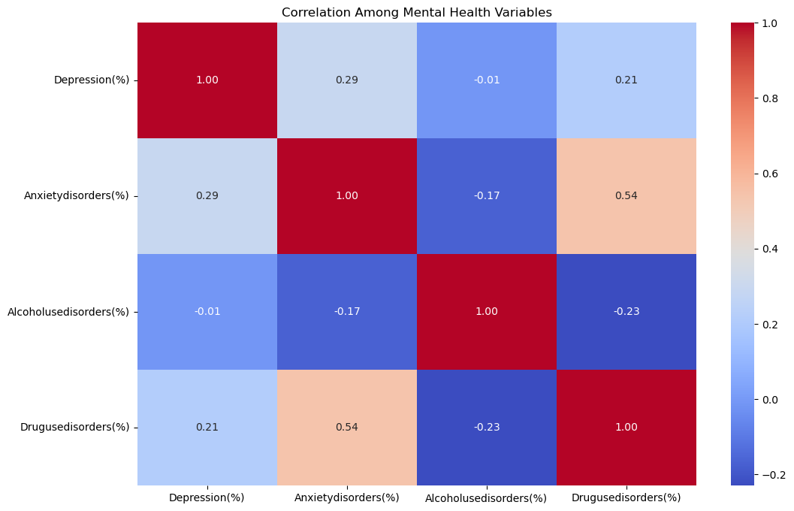
Correlation Among Mental Health Variables
Drug Use Disorder - Anxiety Disorder = 0.54
Anxiety Disorder - Depression = 0.29
Depression - Drug Use Disorder = 0.21
Alcohol Use Disorder - Depression = -0.01
Anxiety Disorder - Alcohol Use Disorder = -0.17
Alcohol Use Disorder - Drug Use Disorder = -0.23

Slide 18
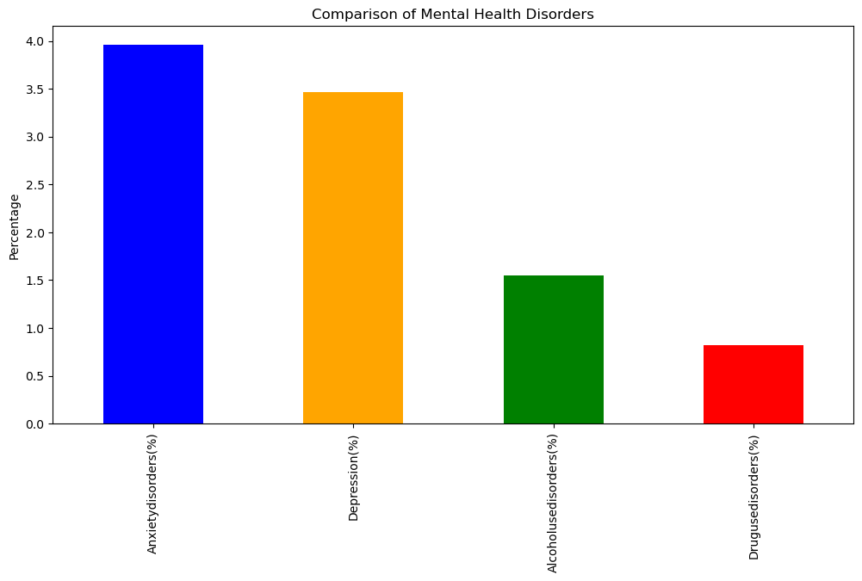
Mental Health Disorders

Slide 19
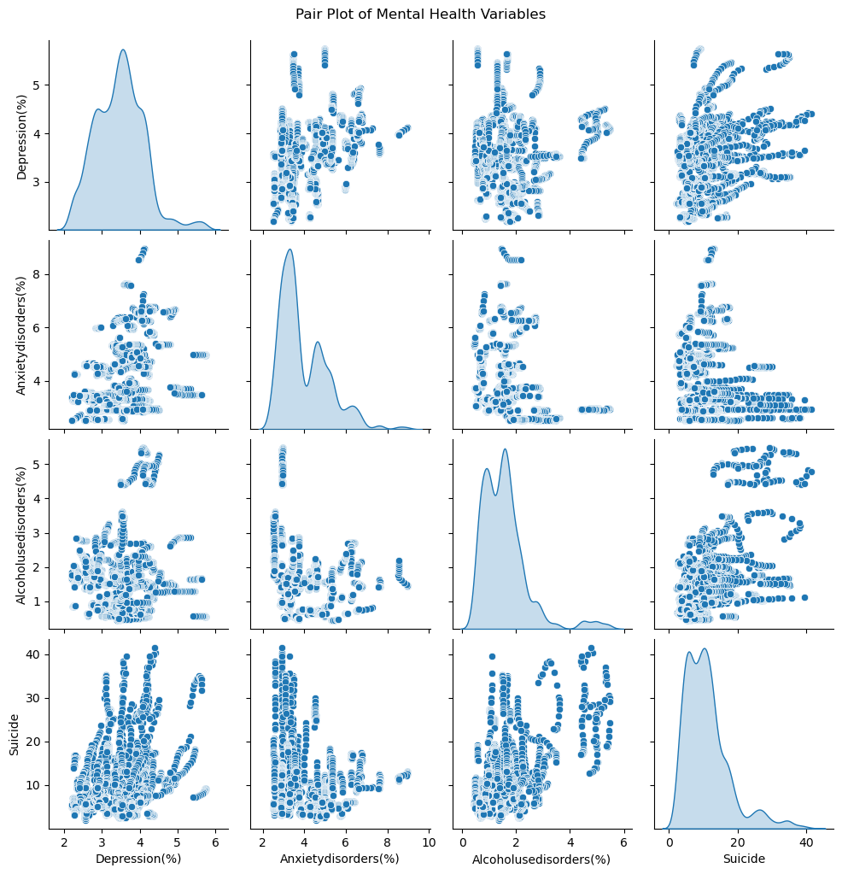
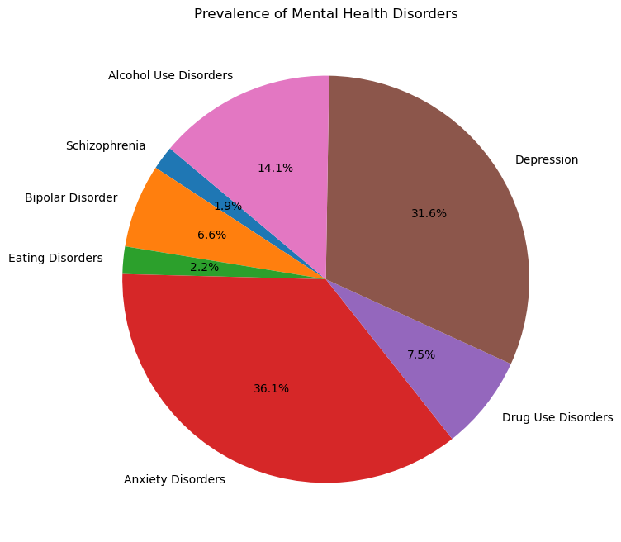
Mental Health Disorders

Slide 20
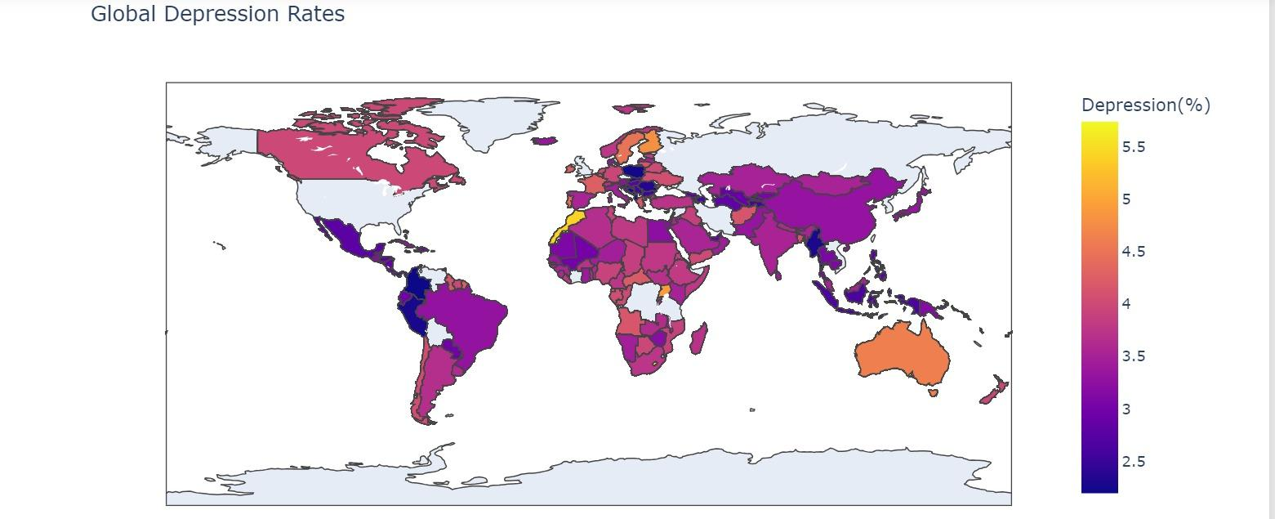
Depression Disorders

Slide 21
Modeling

Slide 22
Panel Regression
Unit root test
Differential
Model Selection
Correlation test & Heteroscedasticity test
Model adjustment

Slide 23
HT Test
Variables | schizophrenia | bipolar disorder | eating disorder | anxiety disorder | drug use disorder | depression | alcohol use disorder | population | suicide
p-values | 0.4227 | 0.4798 | 0.7689 | 0.4389 | 0.8170 | 0.2352 | 0.3346 | 0.9305 | 0.0013
Variables | D_schizophrenia | D_bipolardisorder | D_eatingdisorder | D_anxietydisorder | D_drug use disorder | D_depression | D_alcoholusedisorder | D_population
p-values | 0.0424 | 0.0000 | 0.0000 | 0.0000 | 0.0000 | 0.0000 | 0.0000 | 0.0438
Variables | D2_schizophrenia | D2_population
p-values | 0.0000 | 0.0000

Slide 24
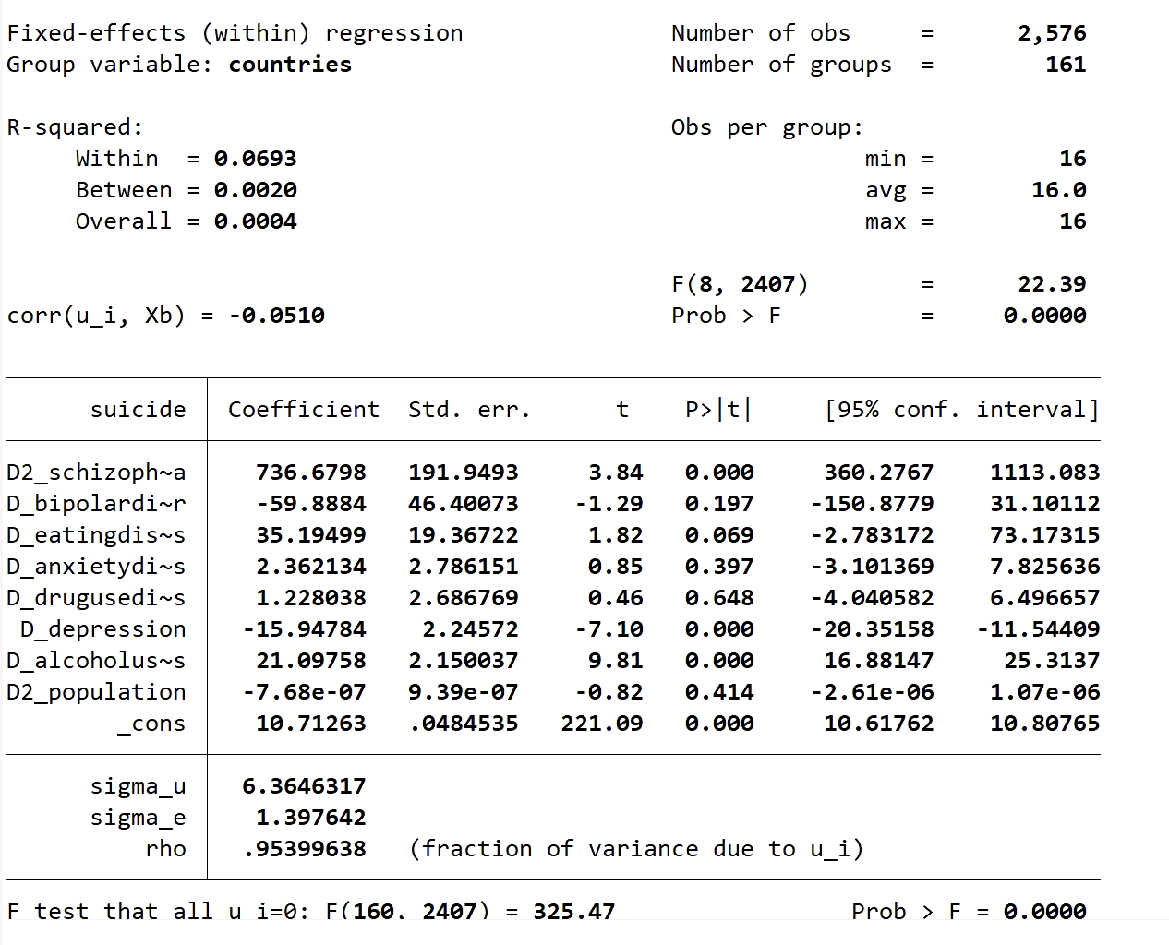
Model Selection

Slide 25
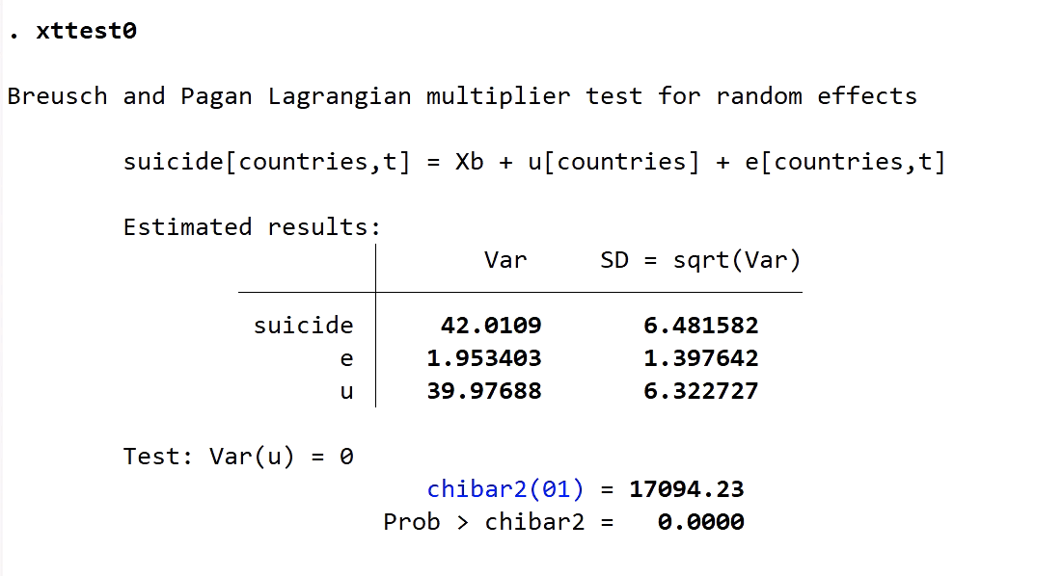
Model Selection

Slide 26
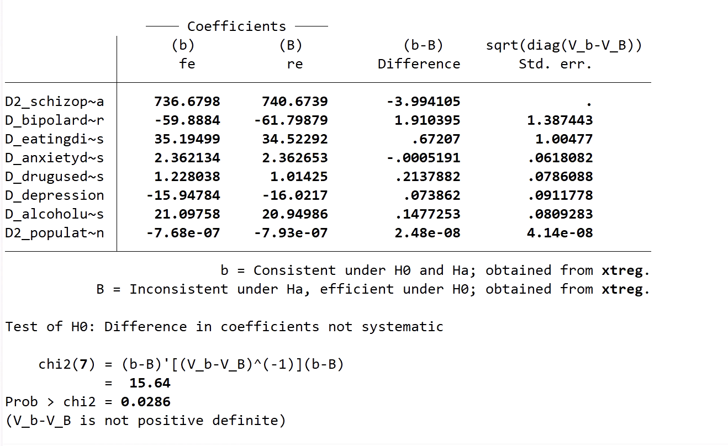
Model Selection

Slide 27
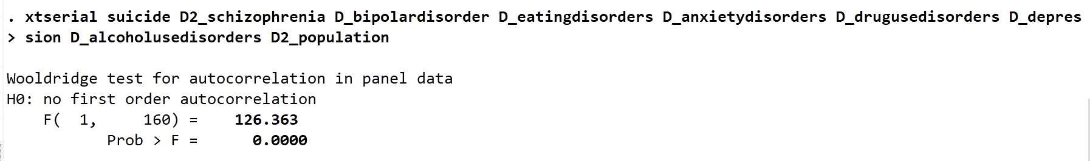
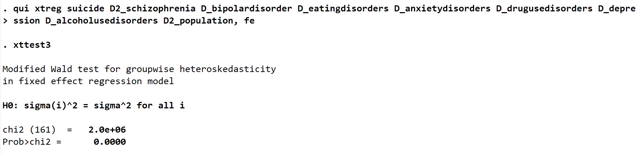
Correlation test & Heteroscedasticity test

Slide 28
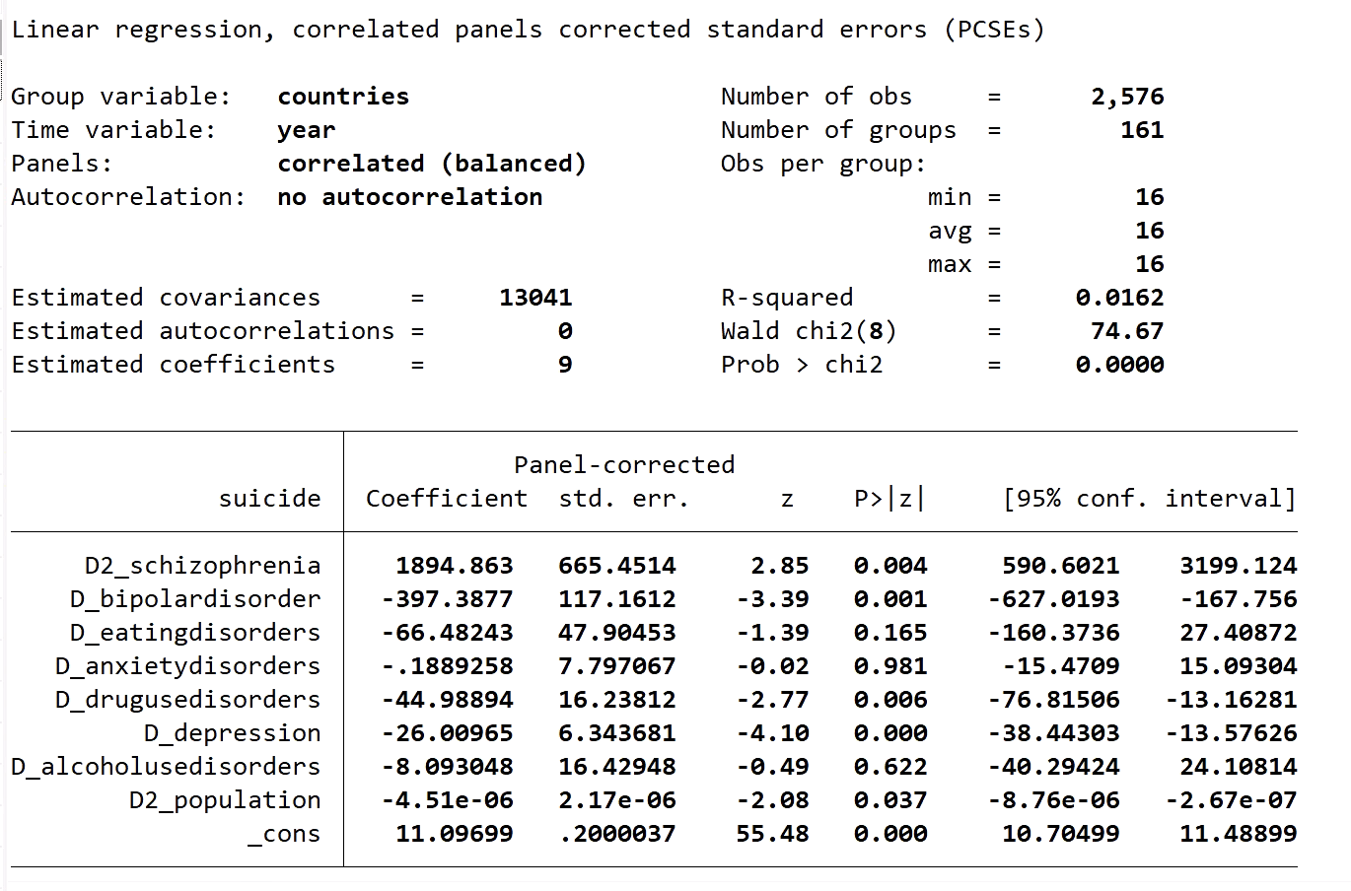
Model Adjustment

Slide 29
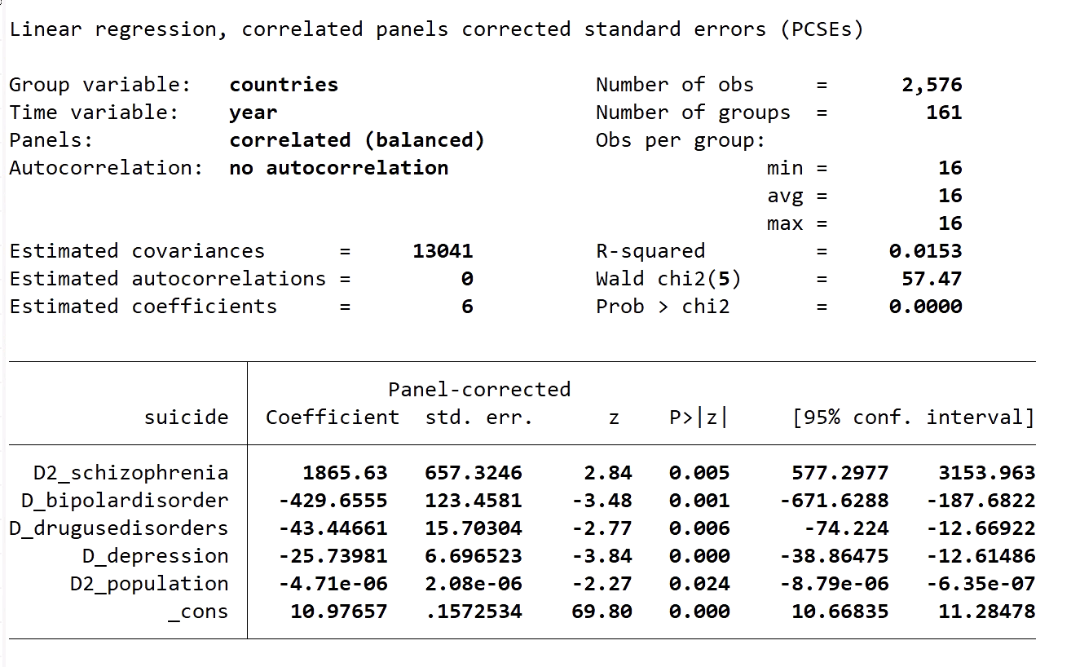

Slide 30
Conclusions
Schizophrenia, bipolar disorder, drug use disorder and depression are the psychiatric symptoms most associated with suicide
Bipolar disorder is also a mental illness strongly associated with suicide and has often been underestimated in the past

Slide 31
Thank you

